Slide 1
WIRELESS MOBILE CHARGING SYSYTEM

Slide 2
ABSTRACT:
The main objective of Wireless Charger System is to charge the mobile battery by using wireless charger.
The dream of wireless charging is just to be able to plop your phone on a shelf after work and have it fully charged when you pick it up again on your way out.
This technology will replace cables and standardize on one interface, potentially being able to adjust power settings to charge different types of batteries.
In our Wireless charging system there are two circuits, a transmitter circuit and a receiver circuit.

Slide 3
Continued….,
The transmitter circuit consists of step down transformer of 230/12V. This transformer steps down 230V AC from main supply to 12V AC. Then that 12V AC is converted into 12V DC with the help of bridge rectifier. After that a 2200/25V capacitor is used to filter the ripples and pure DC is supplied. Then the oscillator circuit oscillates at 10MHz and with the help of transmitting coil it transmits the wireless power.
The receiver circuit receives the power through receiving coil and passes through voltage multiplier circuit (consisting of diode and capacitor voltage multiplier) and through that voltage the mobile charging is achieved.

Slide 4
EXISTING SYSTEM
Whenever we use the devices in our day to day activities and whatever may be the devices we use, it becomes essential to recharge the devices regularly with the help of wired chargers. But, there may be a situation that there may be no power supply due to some natural hazards may include cyclone, earth quake and etc. In that case, is there any possibility to transfer the power from one mobile phone to another mobile phone wirelessly , this issue in their work by eliminating the need of physical power supply to the portable devices where the easy transfer of power from one mobile phone to another mobile phone can be done using inductive coupling

Slide 5
PROPOSED SYSTEM
a wireless battery charger has been proposed for mobile phone charging which is expected to eliminate all the hassles with today’s battery technology. The advantage of this device is that it can wirelessly charge up the batteries which can save time and money in a long run for the general public.

Slide 6
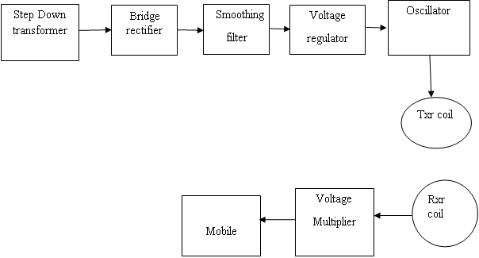
Block Diagram:

Slide 7
HARDWARE'S
Stepdown Transformers
Inductive Coils
Regulator

Slide 8
Advantages:
Cost efficient

Slide 9
Applications:
Mobile power supply appliucations

